Slide 1
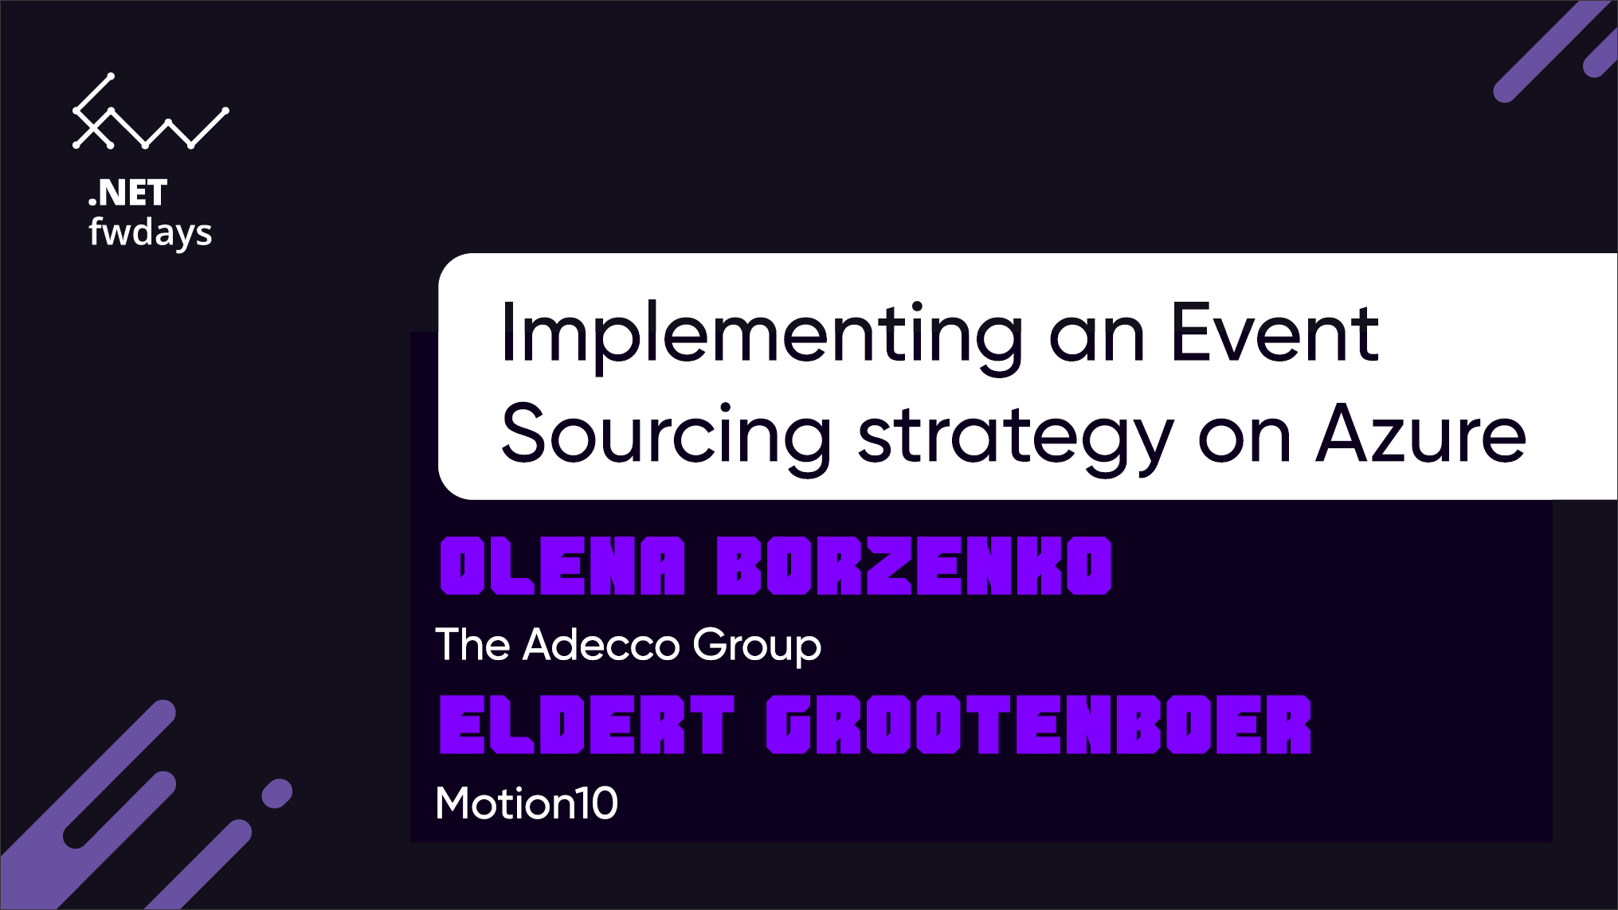
Implementing an Event Sourcing strategy on Azure
Notes:
30 minutes!
Context, why this session, Durstexpress

Slide 2
Implementing an Event Sourcing strategy on Azure
Notes:
25 minutes!

Slide 3
Eldert Grootenboer & Olena Borzenko
Motion10
Azure MVP
@egrootenboer
The Adecco Group
@borzenko_lena

Slide 4
Event Sourcing

Slide 5
Event Sourcing
Order Created
Added 2 Shirts
Added 4 Hats
Shipping Info Added

Slide 6
Why use Event Sourcing?
CRUD
Locking data
Not easily scalable
Concurrency is difficult
No history
Notes:
Most applications work with data, and the typical approach is for the application to maintain the current state of the data by updating it as users work with it. For example, in the traditional create, read, update, and delete (CRUD) model a typical data process is to read data from the store, make some modifications to it, and update the current state of the data with the new values—often by using transactions that lock the data.
The CRUD approach has some limitations:
CRUD systems perform update operations directly against a data store, which can slow down performance and responsiveness, and limit scalability, due to the processing overhead it requires.
In a collaborative domain with many concurrent users, data update conflicts are more likely because the update operations take place on a single item of data.
Unless there's an additional auditing mechanism that records the details of each operation in a separate log, history is lost.

Slide 7
Event sourcing pattern
Write-heavy workloads
Inserts are more efficient
Built-in audit log
Don’t update objects
Notes:
Write-heavy workloads. Store each event as an immutable document, instead of updating state in-place
AddEventForObject(ObjectId, EventType, Timestamp)
GetEventsForObject(ObjectId, EventType)
GetEventsSinceTimestamp(Timestamp)
Why event-driven architectures?
Inserts are more efficient than update at scale
Built-in audit log of events
Decoupled micro-services that act on events
GetEventsForObject is a single-partition query to get latest state on read QUESTION from Olena: You mentioned before problems with scalability, can you tell us how it will work in this case?

Slide 8
Advantages
Events are immutable and can be stored using an append-only operation. The user interface, workflow, or process that initiated an event can continue, and tasks that handle the events can run in the background. This, combined with the fact that there's no contention during the processing of transactions, can vastly improve performance and scalability for applications, especially for the presentation level or user interface.
Events are simple objects that describe some action that occurred, together with any associated data required to describe the action represented by the event. Events don't directly update a data store. They're simply recorded for handling at the appropriate time. This can simplify implementation and management.
Events typically have meaning for a domain expert, whereas object-relational impedance mismatch can make complex database tables hard to understand. Tables are artificial constructs that represent the current state of the system, not the events that occurred.
Event sourcing can help prevent concurrent updates from causing conflicts because it avoids the requirement to directly update objects in the data store. However, the domain model must still be designed to protect itself from requests that might result in an inconsistent state.
The append-only storage of events provides an audit trail that can be used to monitor actions taken against a data store, regenerate the current state as materialized views or projections by replaying the events at any time, and assist in testing and debugging the system. In addition, the requirement to use compensating events to cancel changes provides a history of changes that were reversed, which wouldn't be the case if the model simply stored the current state. The list of events can also be used to analyze application performance and detect user behavior trends, or to obtain other useful business information.
The event store raises events, and tasks perform operations in response to those events. This decoupling of the tasks from the events provides flexibility and extensibility. Tasks know about the type of event and the event data, but not about the operation that triggered the event. In addition, multiple tasks can handle each event. This enables easy integration with other services and systems that only listen for new events raised by the event store. However, the event sourcing events tend to be very low level, and it might be necessary to generate specific integration events instead.

Slide 9
When to use this pattern
Use this pattern in the following scenarios:
When you want to capture intent, purpose, or reason in the data. For example, changes to a customer entity can be captured as a series of specific event types such as Moved home, Closed account, or Deceased.
When it's vital to minimize or completely avoid the occurrence of conflicting updates to data.
When you want to record events that occur, and be able to replay them to restore the state of a system, roll back changes, or keep a history and audit log. For example, when a task involves multiple steps you might need to execute actions to revert updates and then replay some steps to bring the data back into a consistent state.
When using events is a natural feature of the operation of the application, and requires little additional development or implementation effort.
When you need to decouple the process of inputting or updating data from the tasks required to apply these actions. This might be to improve UI performance, or to distribute events to other listeners that take action when the events occur. For example, integrating a payroll system with an expense submission website so that events raised by the event store in response to data updates made in the website are consumed by both the website and the payroll system.
When you want flexibility to be able to change the format of materialized models and entity data if requirements change, or—when used in conjunction with CQRS—you need to adapt a read model or the views that expose the data.
When used in conjunction with CQRS, and eventual consistency is acceptable while a read model is updated, or the performance impact of rehydrating entities and data from an event stream is acceptable.
This pattern might not be useful in the following situations:
Small or simple domains, systems that have little or no business logic, or nondomain systems that naturally work well with traditional CRUD data management mechanisms.
Systems where consistency and real-time updates to the views of the data are required.
Systems where audit trails, history, and capabilities to roll back and replay actions are not required.
Systems where there's only a very low occurrence of conflicting updates to the underlying data. For example, systems that predominantly add data rather than updating it.

Slide 10
Event Sourcing on Azure

Slide 11
Event Sourcing on Azure
Cosmos DB
Event Hubs
Azure Functions
Notes:
Cosmos DB: Olena
Event Hubs: Eldert
Azure Functions: Olena

Slide 12
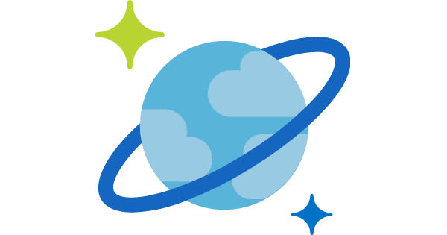

Azure Cosmos DB
A globally distributed, massively scalable, multi-model database service
Elastic scale out
of storage & throughput
Guaranteed low latency at the 99th percentile
Five well-defined consistency models
Turnkey global distribution
Comprehensive SLAs
Notes:
Azure Cosmos DB offers the first globally distributed, multi-model database service for building planet scale apps. It’s been powering Microsoft’s internet-scale services for years, and now it’s ready to launch yours.
You can add Azure locations to your database anywhere across the world, at any time, with a single click. Cosmos DB will seamlessly replicate your data and make it highly available.
Cosmos DB allows you to scale throughput and storage elastically, and globally! You only pay for the throughput and storage you need – anywhere in the world, at any time.

Slide 13
Azure Cosmos DB
A globally distributed, massively scalable, multi-model database service
Column-family
Document
Key-value
Graph
Elastic scale out
of storage & throughput
Guaranteed low latency at the 99th percentile
Five well-defined consistency models
Turnkey global distribution
Comprehensive SLAs
Notes:
Azure Cosmos DB offers the first globally distributed, multi-model database service for building planet scale apps. It’s been powering Microsoft’s internet-scale services for years, and now it’s ready to launch yours.
You can add Azure locations to your database anywhere across the world, at any time, with a single click. Cosmos DB will seamlessly replicate your data and make it highly available.
Cosmos DB allows you to scale throughput and storage elastically, and globally! You only pay for the throughput and storage you need – anywhere in the world, at any time.

Slide 14

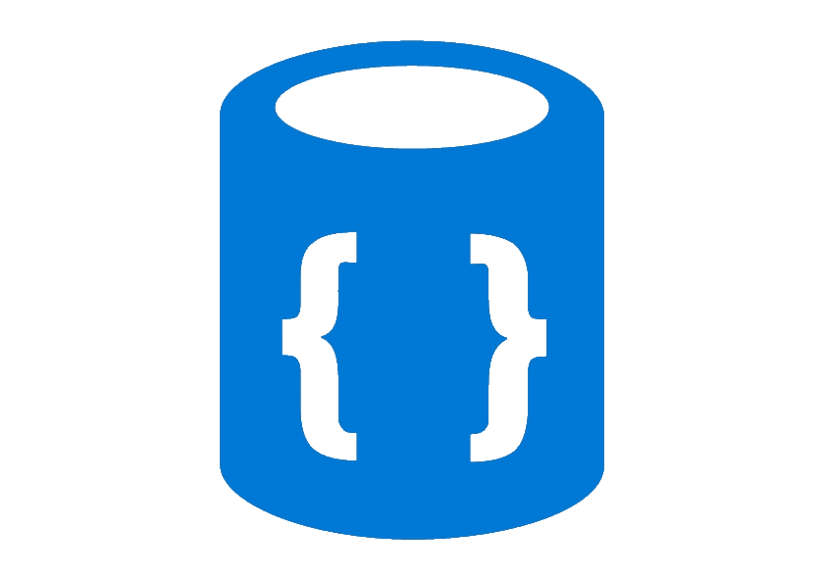

Azure Cosmos DB
A globally distributed, massively scalable, multi-model database service
Cosmos DB’s API for
MongoDB
Table API
Column-family
Document
Key-value
Graph
Elastic scale out
of storage & throughput
Guaranteed low latency at the 99th percentile
Five well-defined consistency models
Turnkey global distribution
Comprehensive SLAs
Notes:
Azure Cosmos DB offers the first globally distributed, multi-model database service for building planet scale apps. It’s been powering Microsoft’s internet-scale services for years, and now it’s ready to launch yours.
You can add Azure locations to your database anywhere across the world, at any time, with a single click. Cosmos DB will seamlessly replicate your data and make it highly available.
Cosmos DB allows you to scale throughput and storage elastically, and globally! You only pay for the throughput and storage you need – anywhere in the world, at any time.

Slide 15
Introducing Azure Event Hubs
IEventProcessor
Event Processor Host
Azure Event Hub
Direct
Receivers
> 1M Producers > 1GB/sec Aggregate Throughput
Consumer Group(s)
Partitions
Event Producers
PartitionKey
Hash
AMQP 1.0
Credit-based flow control
Client-side cursors
Offset by Id or Timestamp
Throughput Units:
1 ≤ TUs ≤ Partition Count
TU: 1 MB/s writes, 2 MB/s reads
Up to 32 partitions via portal, more on request

Slide 16



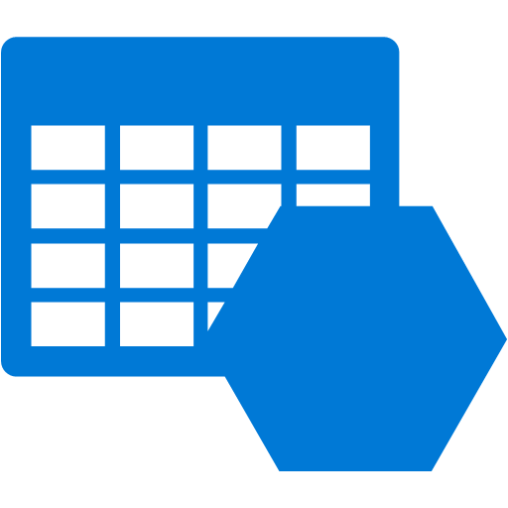





Azure Functions
Events
Code
Outputs
React to timers, HTTP, or events from your favorite Azure services, with more on the way
Author functions in C#, F#, Node.JS, Java, and more
Send results to an ever-growing collection of services

Slide 17
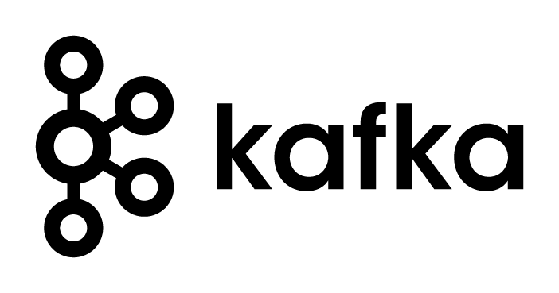



Demo time!
Notes:
Who here is working with Kafka?

Slide 18
Materialized view
Notes:
Why whould we use materialized view? In traditional way when we need to read our data we'd create a query and call it when we need it. With cosmosDB we might want to do it differently because our queries most likely will be quite expensuve. Especially when we have cross partition queries.

Slide 19
Creating a materialized view
More efficient querying
Pre-populated views
Update on change
Cosmos DB Change Feed
Notes:
Materialized View pattern. The data store used in a system based on event sourcing is typically not well suited to efficient querying. Instead, a common approach is to generate prepopulated views of the data at regular intervals, or when the data changes. Shows how this can be done.

Slide 20
Creating a materialized view
Cosmos DB Change Feed

Slide 21
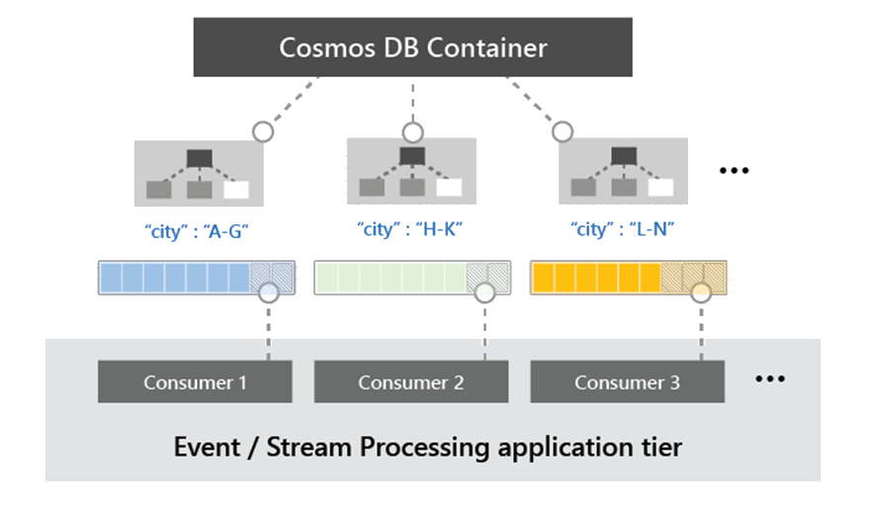
What is Azure Cosmos DB Change Feed?
Allows you to listen to an Azure Cosmos container for any changes.
Outputs the sorted list of documents that were changed in the order in which they were modified.
The changes are persisted, can be processed asynchronously and incrementally
Notes:
For all new workloads – Core (SQL) API
Best developer experience – Azure Cosmos DB product team builds interface, service, and SDKs
For graph data: Gremlin API
Other APIs for migration from that data store and leveraging your existing skills

Slide 22
Materializing Views
Application
Azure Cosmos DB
Materialized View
Order | User | Create Date | …
123abc | Ben6 | 6/17/17
456efg | Ben6 | 3/14/17
789hij | Jen4 | 8/1/16
012klm | Joe3 | 3/4/17
User | Total Orders
Ben6 | 2
Jen4 | 1
Joe3 | 1
Change feed
Notes:
QUESTION: We used to normalize all our data, to prevent duplication as much as possible. This, however, sounds like you will be duplicating data for your different views. Can you elaborate on this?

Slide 23
Features of Azure Cosmos DB Change Feed
Tracks Inserts and Updates
Doesn’t Track Deletes - more on that later
Items ordered of their modification time
Only the most recent change is present
Order is guaranteed at logical partition key value
Isn't a duplication of data already in the container
Supports multi-region accounts
Enabled by default
Charged for RUs consumed
Charged for RUs consumed by the lease container.

Slide 24
Demo time!

Slide 25

Demo time!

Slide 26
Connecting our consumers

Slide 27
Event Grid
SignalR

Slide 28

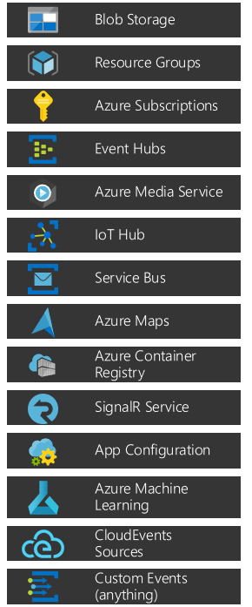
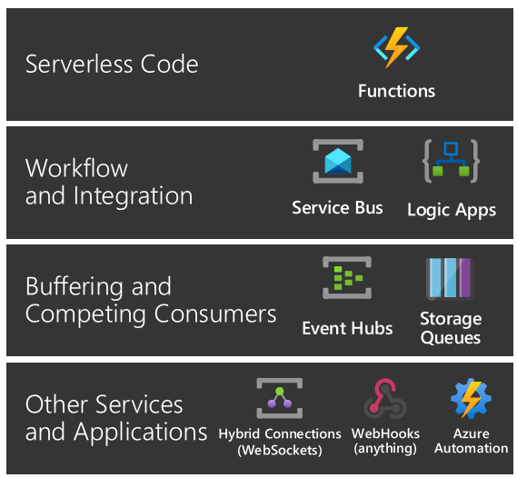


Azure Event Grid
Events: what happened
Event Publishers: where it took place
Topics: where publishers send events
Event Subscriptions: how you receive events
Event Handlers: the app or service reacting to the event

Slide 29
Azure SignalR Service
Features:
Handles connection management automatically.
Sends messages to all connected clients simultaneously.
Sends messages to specific clients or groups of clients.
Scales to handle increasing traffic.
Transports
WebSockets
Server-Sent Events
Long Polling

Slide 30


Demo time!

Slide 31
Almost done!

Slide 32
Key take-aways
Use the Azure eco-system for easy and powerful solutions
Cosmos DB is a great central append-only persistent data store
Prepare materialized views for various consumers
Use event-sourcing on Azure with heavy write loads
Notes:
Olena
Eldert
Olena
Eldert
Synapse

Slide 33
Thank you!
@egrootenboer
https://www.linkedin.com/in/eldert-grootenboer/
@borzenko_lena
https://www.linkedin.com/in/olena-borzenko/

